Slide 1

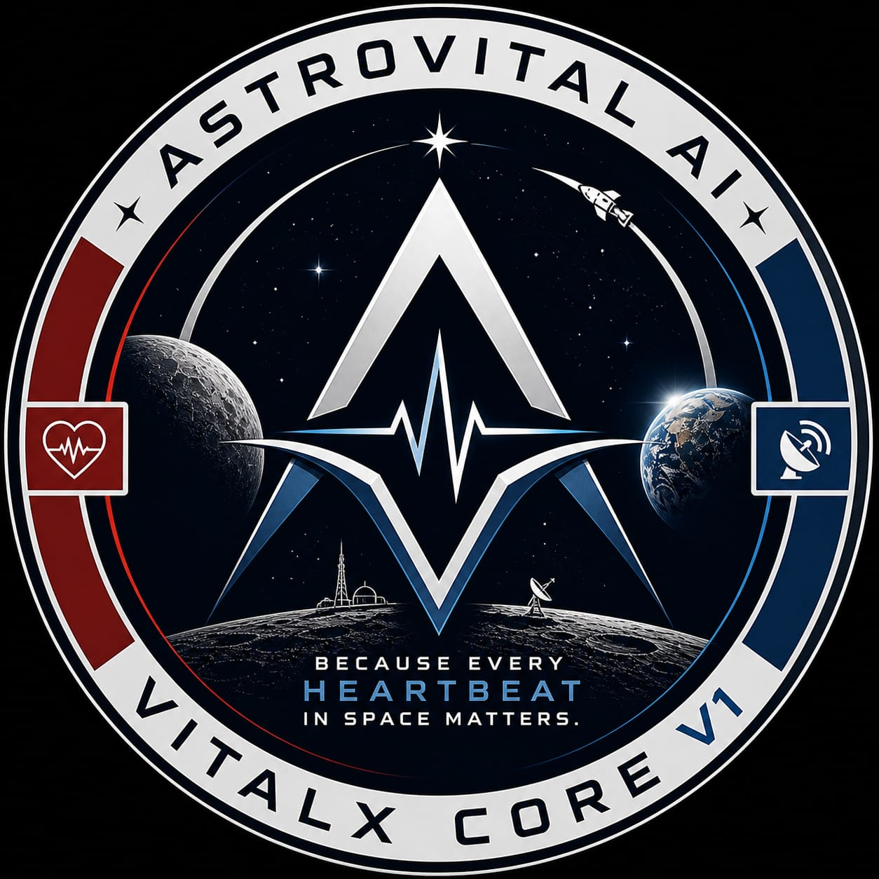
ASTROVITAL AI : VITALX CORE V1
India's First Independent Space Health AI
Developer: Gouragopal Mohapatra
Independent Researcher | May 2026
GitHub: GOURGOPAL618
01

Slide 2
Who Am I
2nd Year B.Tech — AI & Data Science
Independent Researcher — no institution
7 solo projects before ASTROVITAL AI
12 peer-reviewed papers read
57 days — 12 notebooks — solo
© 2026 Gouragopal Mohapatra — All Rights Reserved
02

Slide 3
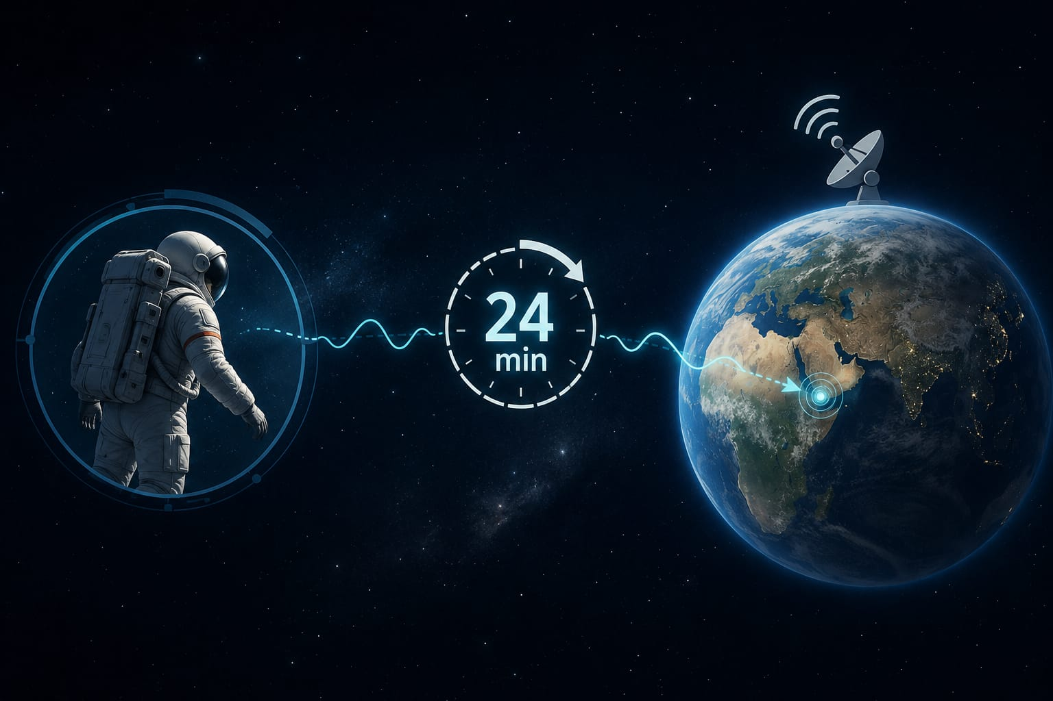
The Problem:
No hospital in deep space
Mars delay — 24 minutes
Current systems — reactive
6 health threats simultaneously
© 2026 Gouragopal Mohapatra — All Rights Reserved
03

Slide 4
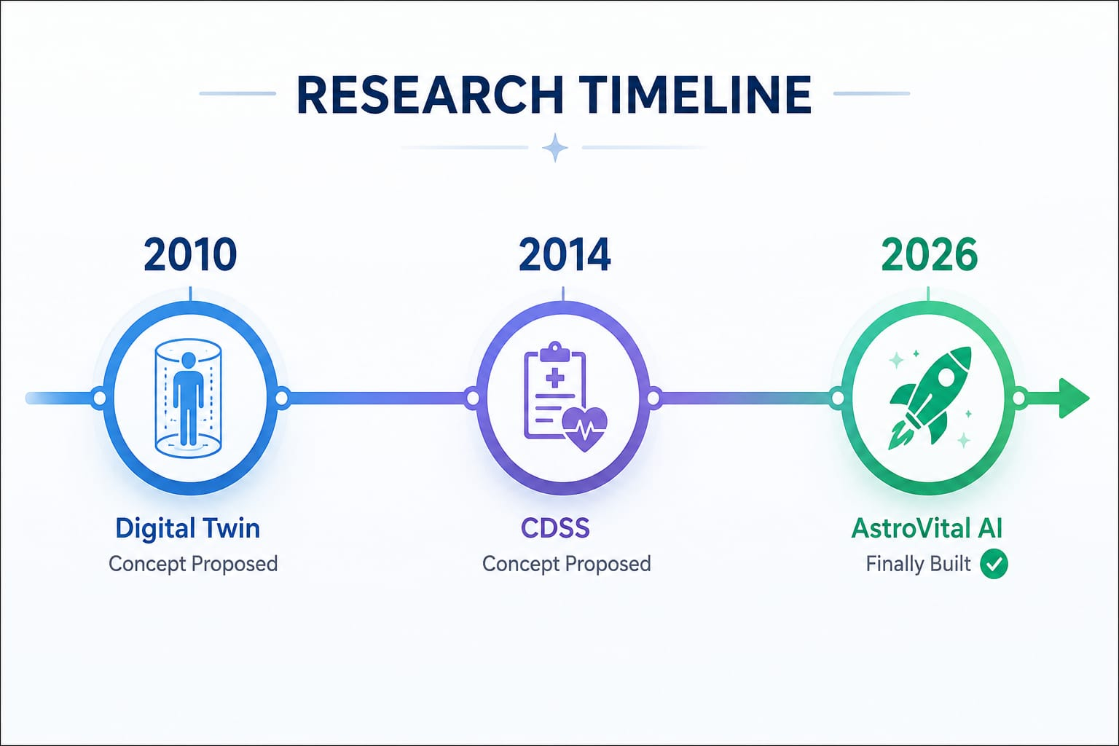
The Research Gap:
CDSS proposed — 2014
Digital Twin — 2010
12-16 years — only theory
Nobody built it
© 2026 Gouragopal Mohapatra — All Rights Reserved
04

Slide 5
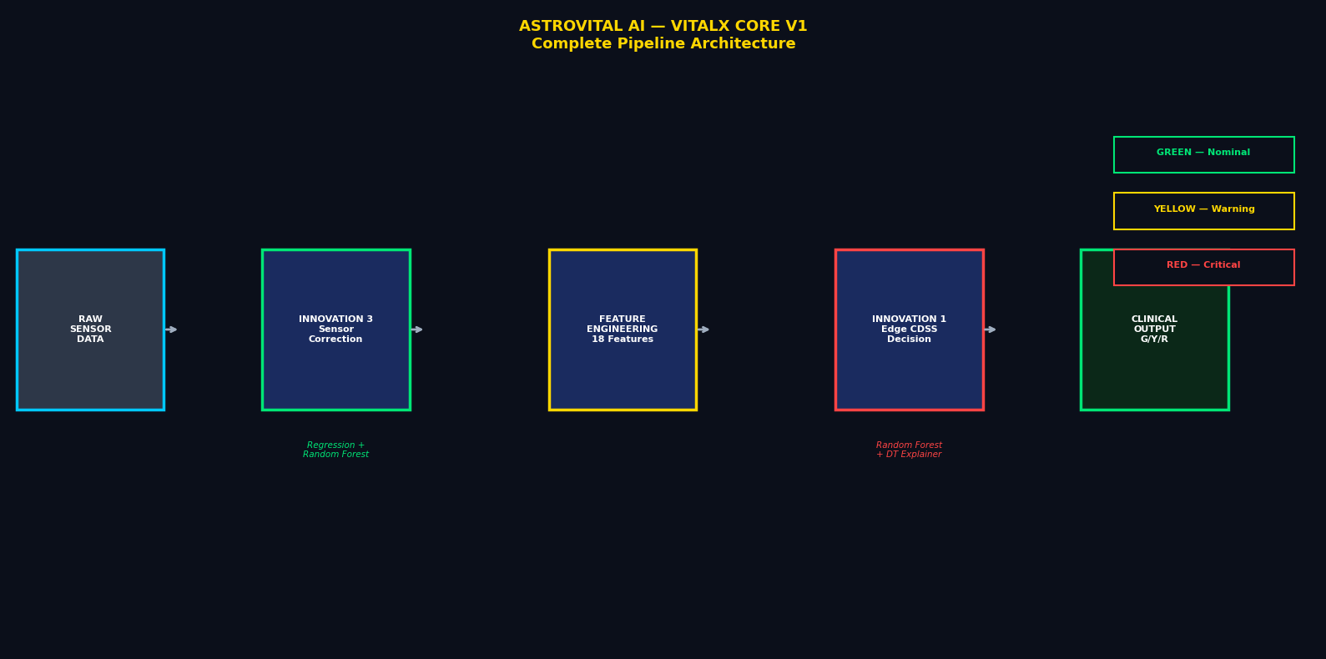
What I Built:
13 notebooks
3 working innovations
6 production models
Edge deployed — no cloud
© 2026 Gouragopal Mohapatra — All Rights Reserved
05

Slide 6
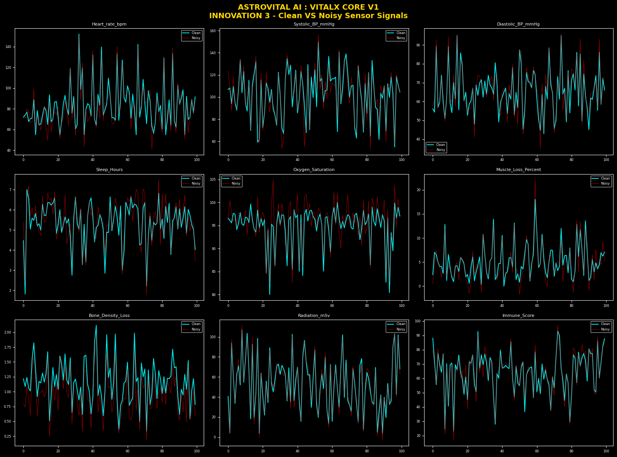
Innovation 3:
Space sensors get corrupted
Radiation, sweat, movement
R2 = 0.823
9 sensors corrected
© 2026 Gouragopal Mohapatra — All Rights Reserved
06

Slide 7
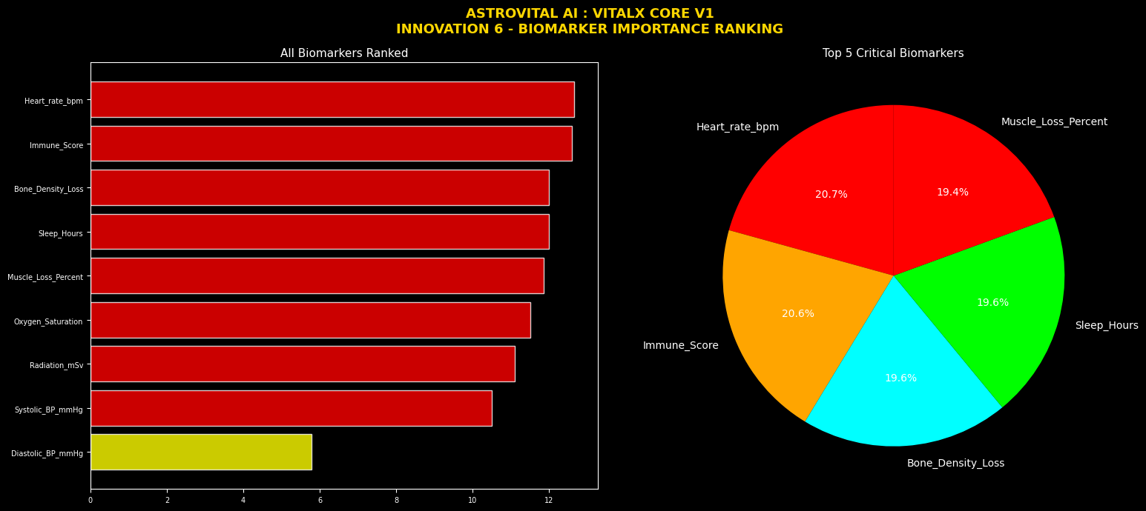
Innovation 6:
14 parameters analyzed
Which data actually matters?
Data-driven ranking
Top biomarkers identified
© 2026 Gouragopal Mohapatra — All Rights Reserved
07

Slide 8
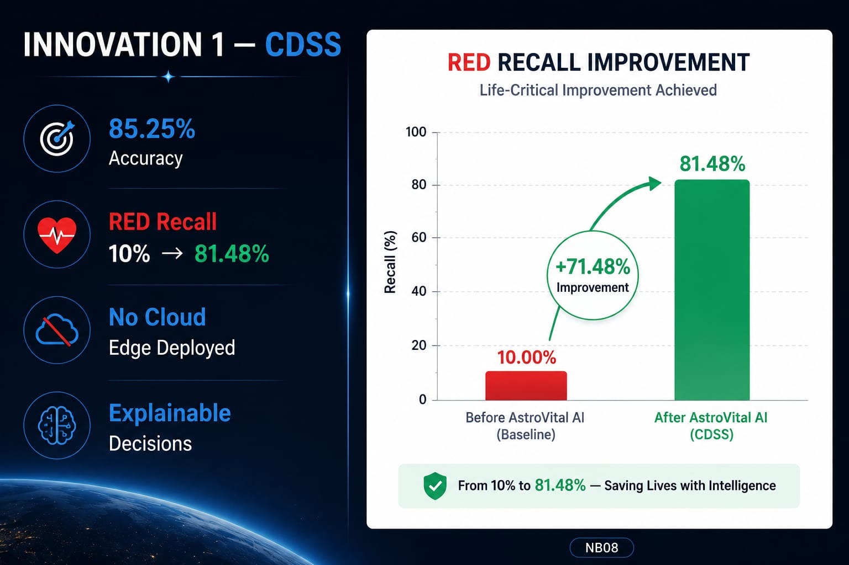
Innovation 1:
85.25% accuracy
RED recall 10% → 81.48%
No cloud needed
Explainable decisions
© 2026 Gouragopal Mohapatra — All Rights Reserved
08

Slide 9
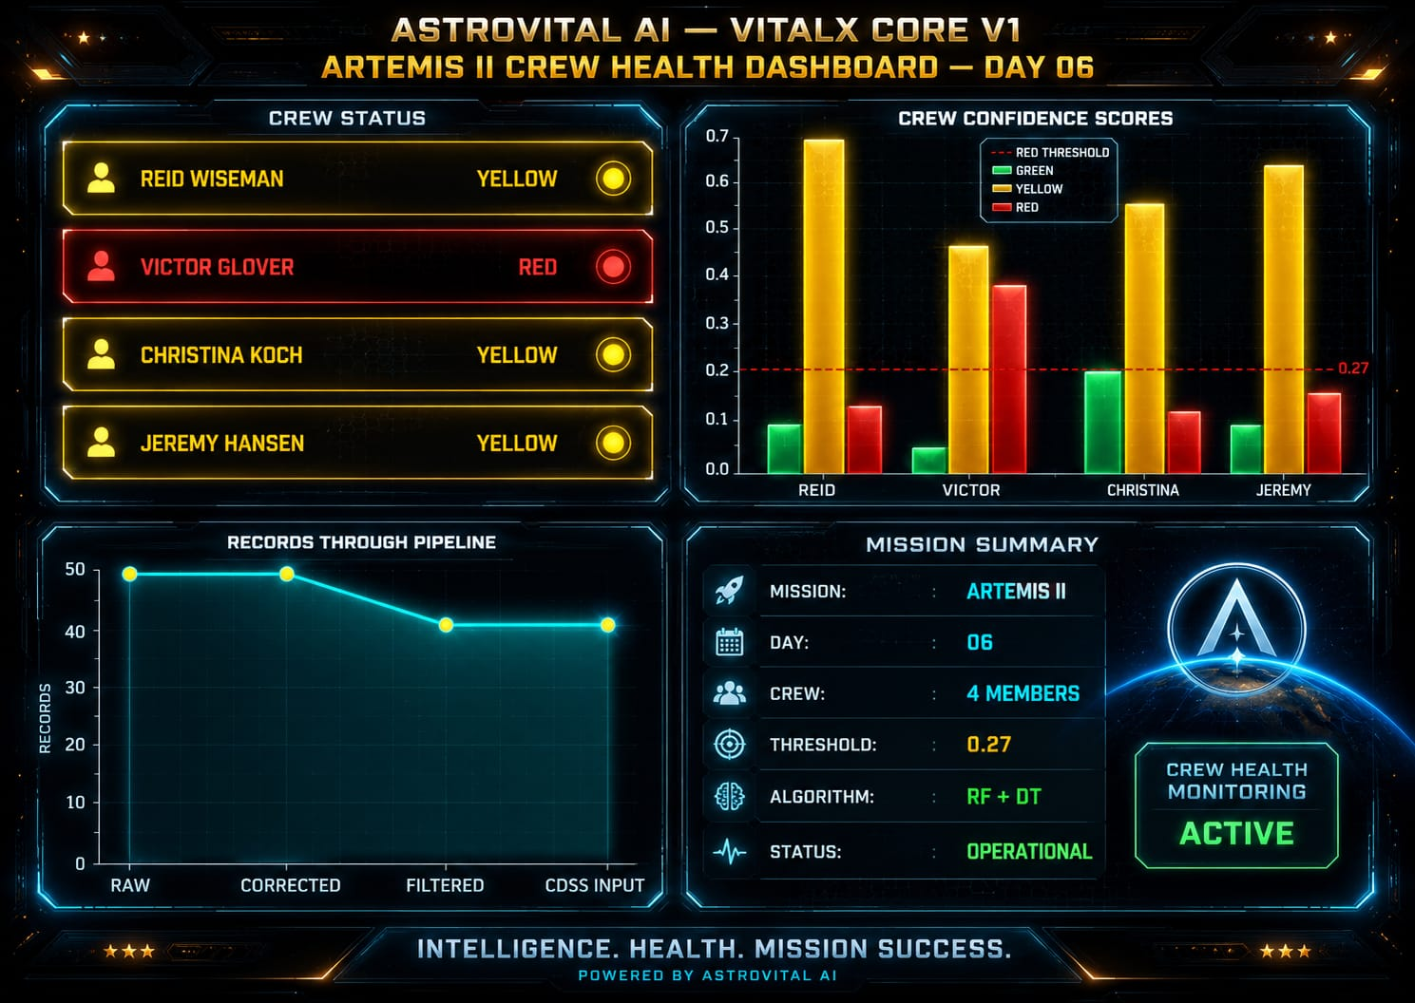
Real Mission Demo: ARTEMIS II
© 2026 Gouragopal Mohapatra — All Rights Reserved
09

Slide 10
Why ASTROVITAL for You:
Pixxel / GalaxEye:
Remote sensing + health data
V3 NEURALBEAT targets satellite health
Skyroot / Agnikul:
Mission-critical health systems
Launch crew safety
Dhruva Space:
Satellite systems
Health monitoring
© 2026 Gouragopal Mohapatra — All Rights Reserved
10

Slide 11
FUTURE OF ASTROVITAL:
V1
VITALX CORE
✅ DONE
V1.5
AEREXIS OMEGA
🔵 Next
V2
OMNISENITEL
⏳ Planned
V3
NEURALBEAT
⏳ Planned
© 2026 Gouragopal Mohapatra — All Rights Reserved
11

Slide 12

Research Credibility:
12 papers reviewed
Independent research
Acta Astronautica target
© 2026 Gouragopal Mohapatra — All Rights Reserved
12

Slide 13
Conclusion:
"Because Every Heartbeat in Space Matters."
GitHub – GOURGOPAL618
Available for internship / collaboration
© 2026 Gouragopal Mohapatra — All Rights Reserved
13

Slide 14
THANK YOU
VITALX CORE V1 – AN INTELLECTUAL PROPERTY AND THE 1ST PRODUCT OF ASTROVITAL AI .
© 2026 ASTROVITAL AI — All Rights Reserved
© 2026 Gouragopal Mohapatra — All Rights Reserved
14

